Slide 1
You Lose GPT: A horror Experience

Slide 2
Group Objective
To entertain the user through the medium of a game, while also demonstrating a mastery of the topics covered in CS- 316 chapter 8 -13.

Slide 3
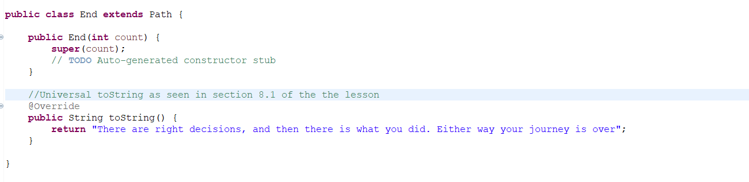
How we used Ch.8
We used the Universal toString, as seen in chapter 8 as shown below, this made sending Strings from other methods very efficient.

Slide 4
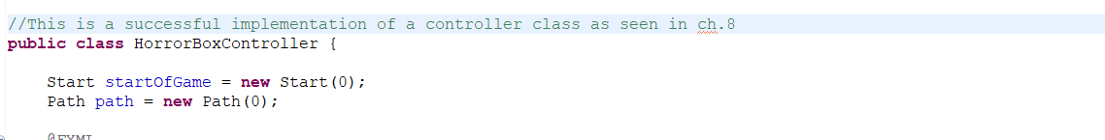
We did not directly interact with any of the html elements within the fxml file, instead relying on the controller class as shown below. This made the logic- element relationship very easy to follow.

Slide 5
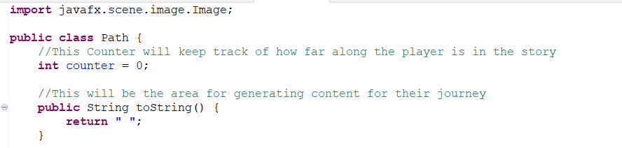
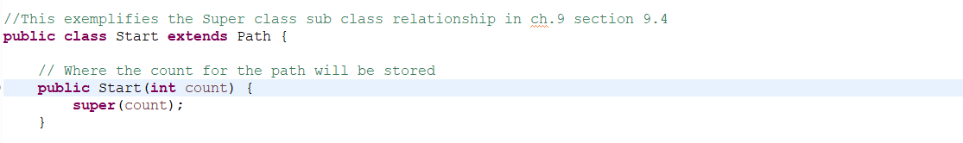

Slide 6
Ch.10-11 Section here onward

Slide 7
Ch.12-13 here onward: Gui Parts 1 and 2
Chapter 12 Material Used:
12.5: Event Handling
Use of Application class, defining values for property and control, visual design within fxml, importing classes for use in the controller and normal classes, static and instance var, fx:id, FXML Loader, Action Events
12.4: use of GUI: adding and editing
Control (buttons, labels, text fields), Stage, Scenes (each story point), Layout containers (walking buttons, gridpanes), Event Handler and Controller Class
Chapter 13:
13.3: Panes and Boxes, Mouse Event Handling, Setting User Data, @fxml variables, Property Bindings and Listeners
13.5: stage.set for data-driven GUIs
All of these made the fxml file adaptable and able to change with both user input and input from the programmer. This is easier to attach data to visual elements and manipulate both the data and elements.

Slide 8





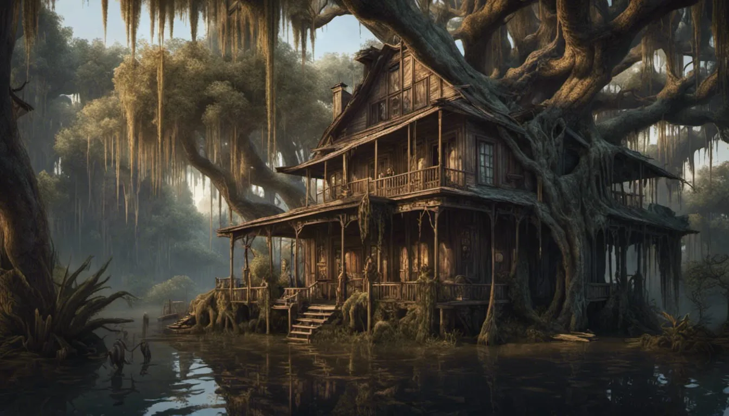
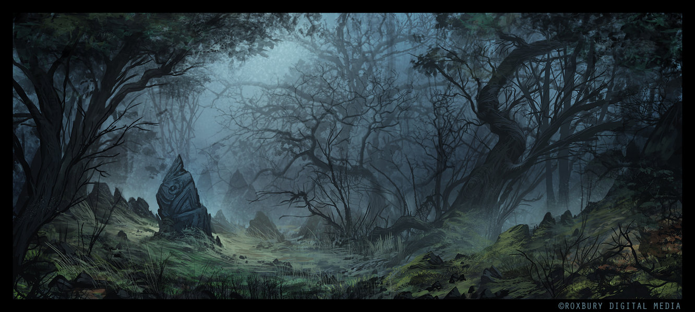





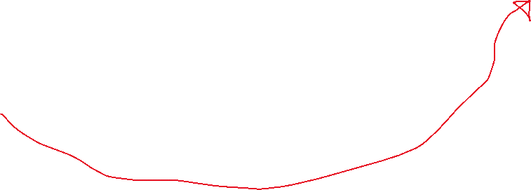


Storyline for youlosegpt
Affected the code we used to determine which image went where.
Cry
Left
Right
Straight

Slide 9

Thank you
Brita Tamm
502-555-0152
brita@firstupconsultants.com
www.firstupconsultants.com

